Slide 1
Project Scope Management
www.hndit.com

Slide 2
Learning Objectives
www.hndit.com
Understand the elements that make good project scope management important.
Explain the scope planning process and describe the contents of a scope management plan.
Describe the process for developing a project scope statement using the project charter and preliminary scope statement.
Discuss the scope definition process and work involved in constructing a work breakdown structure using the analogy, top-down, bottom-up, and mind-mapping approaches.

Slide 3
Learning Objectives
www.hndit.com
Explain the importance of scope verification and how it relates to scope definition and control.
Understand the importance of scope control and approaches for preventing scope-related problems on information technology projects.
Describe how software can assist in project scope management.

Slide 4
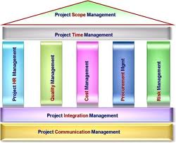
Project Scope Management
www.hndit.com

Slide 5
Project Scope Management
www.hndit.com
Project Scope Management includes the processes required to ensure that the project includes all the work required, and only the work required, to complete the project successfully.
Major project scope management processes:
Initiation
Scope Planning
Scope Definition
Scope Verification
Scope Change Control

Slide 6
What is Project Scope Management?
www.hndit.com
Scope refers to all the work involved in creating the products of the project and the processes used to create them.
A deliverable is a product produced as part of a project, such as hardware or software, planning documents, or meeting minutes.
Project scope management includes the processes involved in defining and controlling what is or is not included in a project.

Slide 7
Project Scope Management Processes
www.hndit.com
Scope planning: Deciding how the scope will be defined, verified, and controlled.
Scope definition: Reviewing the project charter and preliminary scope statement and adding more information as requirements are developed and change requests are approved.
Creating the WBS: Subdividing the major project deliverables into smaller, more manageable components.
Scope verification: Formalizing acceptance of the project scope.
Scope control: Controlling changes to project scope.

Slide 8
Scope Planning and the Scope Management Plan
www.hndit.com
The scope management plan is a document that includes descriptions of how the team will prepare the project scope statement, create the WBS, verify completion of the project deliverables, and control requests for changes to the project scope.
Key inputs include the project charter, preliminary scope statement, and project management plan.

Slide 9
Scope Definition and the Project Scope Statement
www.hndit.com
The preliminary scope statement, project charter, organizational process assets, and approved change requests provide a basis for creating the project scope statement.
As time progresses, the scope of a project should become clearer and more specific.

Slide 10
Creating the Work Breakdown Structure (WBS)
www.hndit.com
A WBS is a deliverable-oriented grouping of the work involved in a project that defines the total scope of the project.
A WBS is a foundation document that provides the basis for planning and managing project schedules, costs, resources, and changes.
Decomposition is subdividing project deliverables into smaller pieces.

Slide 11
Sample Intranet WBS Organized by Product
www.hndit.com

Slide 12
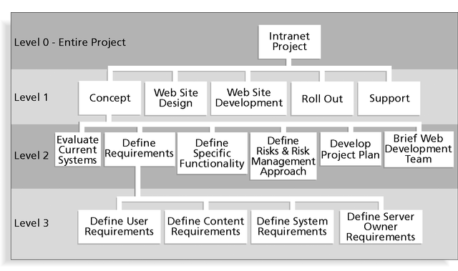
Sample Intranet WBS Organized by Phase
www.hndit.com

Slide 13
Intranet WBS in Tabular Form
www.hndit.com
1.0 Concept
1.1 Evaluate current systems
1.2 Define requirements
1.2.1 Define user requirements
1.2.2 Define content requirements
1.2.3 Define system requirements
1.2.4 Define server owner requirements
1.3 Define specific functionality
1.4 Define risks and risk management approach
1.5 Develop project plan
1.6 Brief Web development team
2.0 Web Site Design
3.0 Web Site Development
4.0 Roll Out
5.0 Support

Slide 14
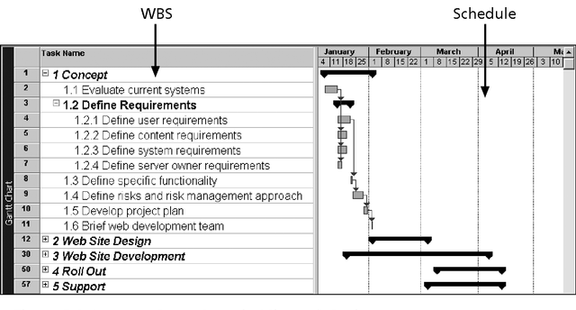
Intranet WBS and Gantt Chart in Project 2000
www.hndit.com

Slide 15
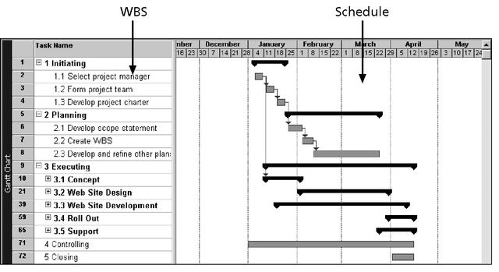
Intranet Gantt Chart Organized by Project Management Process Groups
www.hndit.com

Slide 16
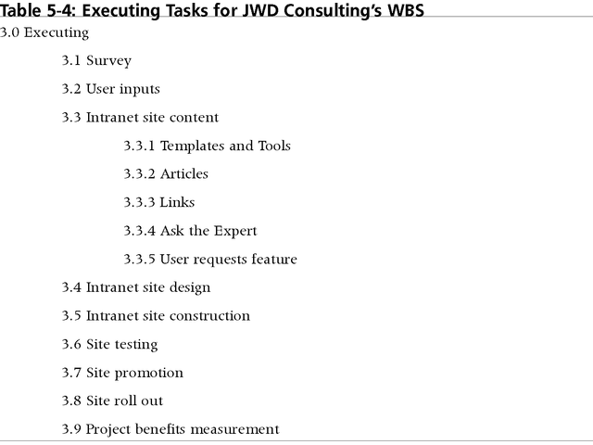
Executing Tasks for JWD Consulting’s WBS
www.hndit.com

Slide 17
Approaches to Developing WBSs
www.hndit.com
Guidelines: Some organizations, such as the DOD, provide guidelines for preparing WBSs.
Analogy approach: Review WBSs of similar projects and tailor to your project.
Top-down approach: Start with the largest items of the project and break them down.
Bottom-up approach: Start with the specific tasks and roll them up.
Mind-mapping approach: Write tasks in a non-linear, branching format and then create the WBS structure.

Slide 18
Scope Verification
www.hndit.com
Verifying scope involves formalizing acceptance of the project deliverables.
Key project stakeholders, such as the customer and sponsor for the project, inspect and then formally accept the deliverables during this process. If the deliverables are not acceptable, the customer or sponsor usually requests changes.
The main outputs of this process, therefore, are accepted deliverables and change requests.

Slide 19
Scope Control
www.hndit.com
Scope control involves controlling changes to the project scope.
Goals of scope control are to:
Influence the factors that cause scope changes.
Ensure changes are processed according to procedures developed as part of integrated change control.
Manage changes when they occur.
Variance is the difference between planned and actual performance.

Slide 20
Project Scope Management Summary
www.hndit.com

Slide 21
Suggestions for Improving User Input
www.hndit.com
Develop a good project selection process and insist that sponsors are from the user organization.
Place users on the project team in important roles.
Hold regular meetings with defined agendas, and have users sign off on key deliverables presented at meetings.
Deliver something to users and sponsors on a regular basis.
Don’t promise to deliver when you know you can’t.
Co-locate users with developers.

Slide 22
Suggestions for Reducing Incomplete and Changing Requirements
www.hndit.com
Develop and follow a requirements management process.
Use techniques such as prototyping, use case modeling, and JAD to get more user involvement.
Put requirements in writing and keep them current.
Create a requirements management database for documenting and controlling requirements.

Slide 23
Suggestions for Reducing Incomplete and Changing Requirements (cont’d)
www.hndit.com
Conduct adequate testing throughout the project life cycle.
Review changes from a systems perspective.
Emphasize completion dates to help focus on what’s most important.
Allocate resources specifically for handling change requests and enhancements (as NWA did with ResNet).

Slide 24
Using Software to Assist in Project Scope Management
www.hndit.com
Word-processing software helps create scope-related documents.
Spreadsheets help perform financial calculations and weighed scoring models, and help develop charts and graphs.
Communication software, such as e-mail and the Web, helps clarify and communicate scope information.
Project management software helps create a WBS, the basis for tasks on a Gantt chart.
Specialized software is available to assist in project scope management.

