Slide 1
HNDIT23022 IT Project Management
www.hndit.com

Slide 2
Module Data
www.hndit.com
Module Code - HNDIT23022
Module Title - IT Project Management
Credits - 02
Hours/Week - Lectures - 15
Lab/Tutorial - 30
GPA/NGPA - GPA
Module Type - Core compulsory

Slide 3
Module Aims & objectives
www.hndit.com
To develop an appreciation of key, generic project management concepts and techniques as well as those techniques and approaches those are specific to the management of software projects.

Slide 4
Learning Outcomes
www.hndit.com
At the end of the module the student will be able to:
Explain how a project can be broken down into stages and what each stage contributes to the project
Select appropriate techniques to use in different stages of a project
Justify the appropriateness of these techniques, and apply them to practical situations
Explain the limitations of the project approach in developing information/software systems
Explain the roles and responsibilities of a project manager
Identify relevant software tools for different project management activities

Slide 5
Outline Syllabus
www.hndit.com
Introduction to project management and the profile of a software project
Project Integration Management
Scope Management
Time Management
Cost Management
Quality Management
Human Resource Management
Communications Management
Risk Management
Procurement Management
Roles and responsibilities of a project Manager

Slide 6
Assessment and Weighting
www.hndit.com
Type | Activity | Weighting
Continuous Assessment | In-class discussions, group work, Assignments and tutorials | 50%
End of semester examination | Structured final examination paper | 50%

Slide 7
Prescribed Text
www.hndit.com
Information Technology Project Management” Kathy Schwalbe, Fourth Edition, THOMSON Course Technology, (ISBN 81-315-0123-X)
Steve McConnell, Software Project Survival Guide, Microsoft Press, ISBN: 1572316217
Harold Kerzner, Project Management: A Systems Approach to Planning, Scheduling, and Controlling, Wiley; 8th edition, ISBN: 0471225770

Slide 8
HNDIT23022 IT Project Management
www.hndit.com
Introduction to project management and the Profile of a software project

Slide 9
What Is a Project?
www.hndit.com
A project is “a temporary endeavor undertaken to accomplish a unique product service or result”
Projects are temporary because they have a definite beginning and a definite end.
They are unique because the product or service they create is different in some distinguishing way from similar products or services.

Slide 10
Project work
www.hndit.com
The following distinguishing characteristics of project work :
Project is unique ,temporary endeavor.
A project manager manages a specific project
People and other resources are not assigned to project managers on an ongoing basis, except for project management support.
A project manager is responsible for the approved objectives of a project – such as budget, schedule, and specifications.

Slide 11
Functional work versus Project work
www.hndit.com
Project work and functional work differ in significant ways.
Functional work is routine, ongoing work.
The following are distinguishing characteristics of functional work:
Ongoing ,routine work
Managers mange the specific function and provide technical direction
People and other resource are assigned to the functional department
Functional departments are responsible for the approved objectives of the function.

Slide 12
Comparison of project and functional work
www.hndit.com
 | Functional Work | Project Work
Type of work
Focus
Management Responsibility
Budgets
Responsiveness to customers and changing environments
Consistency and standards
Cross cultural relevance
Risk
Visibility

Slide 13
Comparison of project and functional work
www.hndit.com
 | Functional Work | Project Work
Type of work | Repeated , ongoing | Unique , often involve changes
Focus | Operations, accomplishing effective work | Completing the project
Management Responsibility | Managing people | Managing work
Budgets | On-going operational | Project budgets to fund specific projects
Responsiveness to customers and changing environments | Less responsive. Longer response time | More responsive. Shorter response time
Consistency and standards | Industry standards | May have few standards because work is unique
Cross cultural relevance
Risk
Visibility

Slide 14
Project Attributes
www.hndit.com
The following attributes help to define a project further :
Attributes of projects
unique purpose
temporary
require resources, often from various areas
should have a primary sponsor and/or customer
involve uncertainty

Slide 15
Example
www.hndit.com
Building a road is an example of a project. The process of building a road takes a finite amount of time, and produces a unique product.
Operations, on the other hand, are repetitive. Generating bills every month, and broadcasting news everyday are examples of operations.
Subprojects are components of a project that often contracted out.

Slide 16
The Triple Constraint
www.hndit.com
Every project is constrained in different ways by its scope, time and cost goals.
These limitations are sometimes referred to in project management as the triple constraint :
Scope goals: What is the project trying to accomplish?
Time goals: How long should it take to complete? What is the project’s schedule.
Cost goals: What should it cost to complete the project? What is the project’s budget?
It is the project manager’s duty to balance these three often competing goals

Slide 17
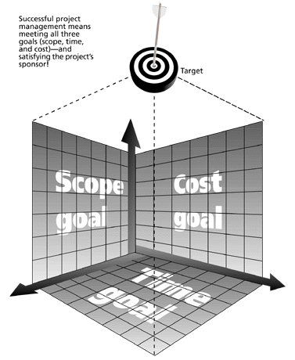
The Triple Constraint of PM
www.hndit.com
Successful project management means meeting all three goals (scope, time, cost) –and satisfying the project’s sponsor.

Slide 18
The Triple Constraint of PM , cont’
www.hndit.com
Although the triple constraints describes how the basic elements of a project –scope, time and cost – interrelate, other elements can also play significant roles.
Quality is often a key factor in projects.
Some people, in fact, refer to the ‘quadruple constraint’ of PM, including quality along with scope, time, and cost.

Slide 19
What is Project Management?
www.hndit.com
Project management is “the application of knowledge, skills, tools, and techniques to project activities in order to meet project requirements”
(PMI*, Project Management Body of Knowledge (PMBOK® Guide), 2000, p. 6)
*The Project Management Institute (PMI) is an international professional society

Slide 20
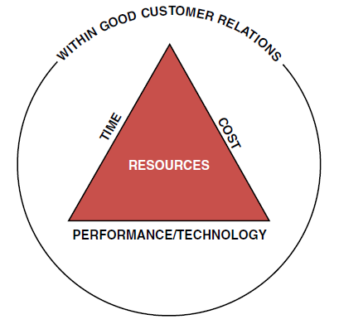
What is Project Management? ….
www.hndit.com
Project management is accomplished through the use of the processes such as:
Project initiation
Project planning
Project execution
Project monitoring and
control
Project closure

Slide 21
Project initiation
www.hndit.com
What is PM?
Select of the best project given resource limits.
Recognizing the benefits of the project
Preparation of the documents to approve the project.
Assigning of project manager

Slide 22
Project planning
www.hndit.com
What is PM?
Definition of the work requirements.
Definition of the quality and quality of work.
Definition of the resources needed
Scheduling the activities
Evaluation of the various risks

Slide 23
Project execution
www.hndit.com
What is PM?
Negotiating for the project team members
Directing and managing the work
Working with the team members to help them improve

Slide 24
Project Monitoring and control
www.hndit.com
What is PM?
Tracking progress
Comparing actual outcome to predicted outcome
Analyzing variances and impacts
Making adjustments

Slide 25
Project closure
www.hndit.com
What is PM?
Verifying that all of the work has been accomplished
Contractual closure of the contract
Financial closure of the charge number
Administrative closure of the paperwork

Slide 26
Project Management Framework
www.hndit.com
A framework for PM includes:
the project stakeholders
PM knowledge areas
PM tools and techniques

Slide 27
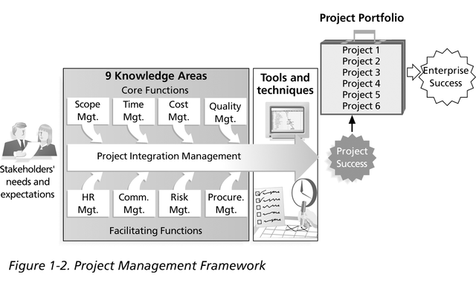
PM Framework , cont’
www.hndit.com

Slide 28
Project Stakeholders
www.hndit.com
PM Framework
Stakeholders are the people involved in or affected by project activities
Stakeholders include
the project sponsor and project team
support staff
customers
users
suppliers
opponents to the project

Slide 29
PM knowledge areas
www.hndit.com
PM knowledge areas describe the key competencies that project managers must develop:
Scope
Time
Cost
quality
human resources
Communication
Risk
procurement management
project integration management
PM Framework
4 core knowledge areas lead to specific project objectives
4 facilitating knowledge areas are the means through which the project objectives are achieved
affects and is affected by all of the other knowledge areas

Slide 30
Project Management Tools and Techniques
www.hndit.com
PM Framework
Project management tools and techniques assist project managers and their teams in various aspects of project management
Some specific ones include
Project Charter, scope statement, and WBS (scope)
Gantt charts, network diagrams, critical path analysis, critical chain scheduling (time)
Cost estimates and earned value management (cost)

Slide 31
Successful projects
www.hndit.com
Successful PM can be defined as having achieved the project objectives:
Within time
Within cost
At the desired performance/technology level
While utilizing the assigned resources effectively and efficiently
Accepted by the customer

Slide 32
Project Success Factors
www.hndit.com
Executive support
User involvement
Experienced project manager
Clear business objectives
Minimized scope
Standard s\w infrastructure
Firm basic requirements
Formal methodology
Reliable estimates
Other criteria such as small milestone, proper planning, competent staff, and ownership

Slide 33
The Context of IT Projects
www.hndit.com
IT Projects
IT projects can be very diverse in terms of size, complexity, products produced, application area, and resource requirements
IT project team members often have diverse backgrounds and skill sets
IT projects use diverse technologies that change rapidly. Even within one technology area, people must be highly specialized

Slide 34
Information Technology projects
www.hndit.com
IT Projects
IT projects involve using hardware, software, and/or networks to create a product, service or result.
Examples :
A help desk or technical worker replaces laptops for a small department
A small s/w development team adds a new feature to an internal software application.
Many organizations upgrade hardware, software, and networks via projects
Organizations develop new software or enhance existing systems to perform many business functions

Slide 35
Special characteristics of an IT project
www.hndit.com
IT Projects
Invisibility: when physical artifacts such as bridge or road is being constructed the progress being made can actually be seen. With software progress is not immediately visible
Complexity: more complex then other engineering works
Conformity : software developers have to conform to the requirement of human clients.
Flexibility

Slide 36
Importance of Software Project Management
www.hndit.com
IT Projects
Software projects have more frailer rate
Final project is invisible until it ends
Software Project use lot of effort, time , recourses & money
The need for Software projects keeps increasing

Slide 37
Advantages of Using Formal PM
www.hndit.com
Better control of financial, physical, and human resources
Improved customer relations
Shorter development times
Lower costs
Higher quality and increased reliability
Higher profit margins
Improved productivity
Better internal coordination
Higher worker morale

Slide 38
Obstacles to successful PM
www.hndit.com
The benefits cannot be achieved without overcoming obstacles such as:
Project complexity
Customer’s special requirements and scope changes
Organizational restructuring
Project risks
Changes in technology
Forward planning and pricing

Slide 39
www.hndit.com
Questions………..

Slide 40
Discussion
www.hndit.com
What is a project, and what are its main attributes?
What is the triple constraint?
What is project management?
Briefly describe the PM framework, providing examples of stakeholders, knowledge areas, tools and techniques and project success factors.
Briefly describe the special characteristics of IT projects.
How IT projects differ from other projects.

Slide 41
Exercise
www.hndit.com
Find any example of a real project with a real project manager. Feel free to use projects in the media or project of your work, if applicable. Write one page paper describing the project in terms of its scope, time and cost goals. Discuss what went right and wrong on the project and the role of the project manager and sponsor. Also describe if the project was success or not and why. Include at least one reference and cite it on the last page. Maximum number of pages of the report is five

