Slide 1
Object Oriented Analysis and Designing
www.hndit.com
Week 04

Slide 2
What is a model?
www.hndit.com
A model is quicker and easier to build
A model can be used in simulations, to learn more about the thing it represents.
A model can evolve as we learn more about a task or problem.
A model can represent real or imaginary things from any domain.

Slide 3
Examples for models
Civil engineers model - bridges, city planners model traffic flow
Economists model – government policy
composers model - music.

Slide 4
Why we need Models?
www.hndit.com
Models help us to visualize a system as it is or as we want it to be.
Models permit us to specify the structure or behavior of a system.
Models give us a template that guides us in constructing a system.
Models document the decisions we have made.

Slide 5
Principles of Object Oriented Modeling:
www.hndit.com
The model should illuminate the most complicated development problems, offering very good insight into the problem.
Every model may be expressed at different levels of precisions.
The best models are connected to reality.
No single model is sufficient. Every system is best approached through a small set of independent models.

Slide 6
What is UML?
www.hndit.com
UML (stands for Unified Modeling Language) is a standard modeling language for specifying, visualizing, constructing, and documenting the artifacts of systems.
UML is different from the other common programming languages like C++, Java, COBOL etc.
UML is a pictorial language used to make system blue prints.

Slide 7
UML
www.hndit.com
• It most directly unifies the methods of
–Booch,
–Rumbaugh (OMT) and
–Jacobson
as well as the best ideas from a number of
other methodologies.

Slide 8
Components and Capabilities
www.hndit.com
• The UML consists of a number of graphical
elements that combine to form diagrams.
• Because it is a language, the UML has rules for
combining these elements.

Slide 9
Building blocks of UML:
www.hndit.com
Things: Things are the most important building blocks of UML. Things can be: Structural, Behavioral, Grouping, and Annotational.
The structural things define the static part of the model. They represent physical and conceptual elements.
The behavioral thing consists of the dynamic parts of UML models.
Grouping things can be defined as a mechanism to group elements of a UML model together.
Annotational things can be defined as a mechanism to capture remarks, descriptions, and comments of UML model elements.
Relationships: It shows how elements are associated with each other and this association describes the functionality of an application.
Diagrams: UML diagrams are the ultimate output of the entire discussion. All the elements, relationships are used to make a complete UML diagram and the diagram represents a system.

Slide 10
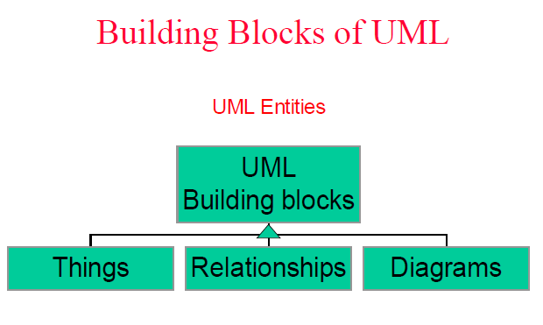
www.hndit.com
The basic entities
in the model.
Is a graph of things and their
relationships.
Tie things together

Slide 11
www.hndit.com

Slide 12
UML
www.hndit.com
UML include many different diagrams.
Class Diagrams :
Shows set of classes, interfaces, and collaborations and their relationships.
Address the static view of a system.
Class diagrams represent the static structure in terms of classes and relationships

Slide 13
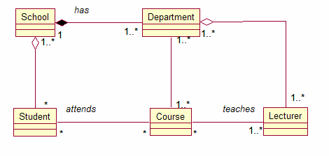
www.hndit.com

Slide 14
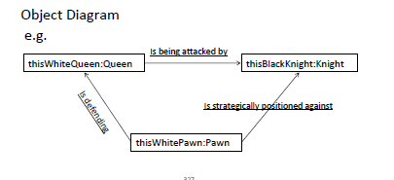
www.hndit.com
2. Object Diagrams :
Shows a set of objects and their relationships.

Slide 15
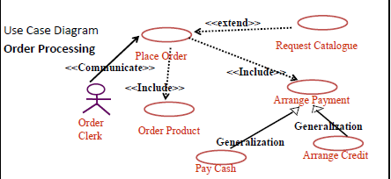
www.hndit.com
3. Use Case Diagrams :
represent the functions of a system from the user's point of view.

Slide 16
www.hndit.com
4. State Diagrams :
represent the behavior of a class in terms of states at run time.
Shows a state machine consisting of states, transitions, events and activities.

Slide 17
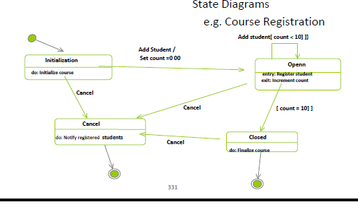
www.hndit.com

Slide 18
5. Sequence Diagrams: An Interaction diagram that emphasizes the time‐ordering of messages
www.hndit.com

Slide 19
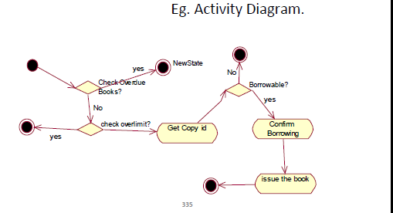
6. Activity Diagram :
diagram that shows the flow from activity to activity within a system.
Address the dynamic view of a system.
www.hndit.com

Slide 20
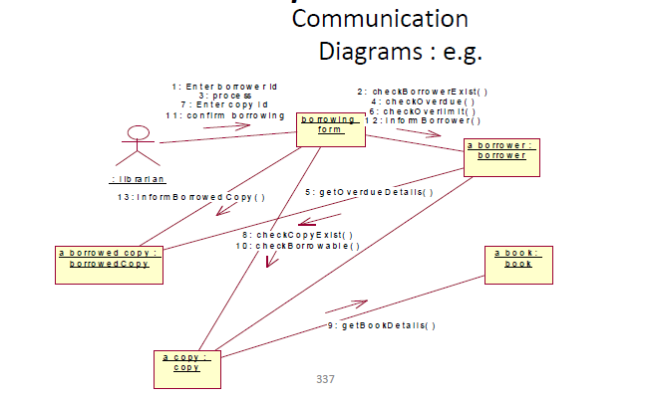
7. Communication Diagrams :
www.hndit.com
An interaction diagram that emphasizes the structural organization of the objects that send and receive messages.
Also known as collaboration diagram.

Slide 21
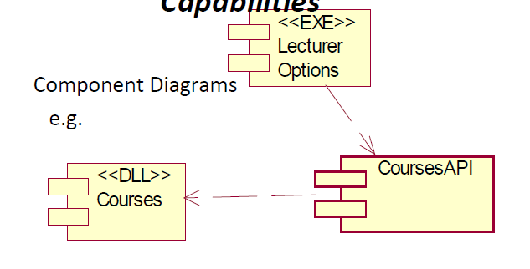
www.hndit.com
8. Component Diagram :
Shows the organizations and dependencies among a set of components.
Address the static implementation view of a system.

Slide 22
www.hndit.com
Deployment Diagram
Shows the configuration of run time processing nodes and the components live on them.
Shows the physical architecture of a computer based system.

Slide 23
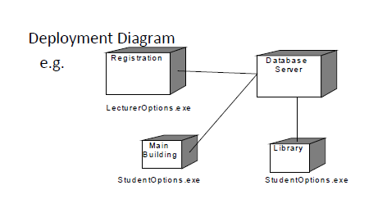
www.hndit.com

Slide 24
www.hndit.com
Composite Structure Diagrams :
New in UML 2.0.
A diagram which shows something about the class’s internal
structure.
Interaction Overview Diagrams :
New in UML 2.0.
A variant on UML activity diagrams which overview control
flow.
Replace some of the activities in the activity diagram with
sequence / communication diagrams (or a combination of
the two)

Slide 25
www.hndit.com
Timing Diagrams :
New in UML 2.0.
A diagram which shows how long an object is in a
particular state.
Package Diagrams:
A diagram which combines a number of classes or
components into a subsystem

Slide 26
end
www.hndit.com

